Slide 1

Stock Price Predictive Analysis
Agenda: Sourced by NCDEX, use Deep learning techniques
To predict the closing price of desired commodities

Slide 2

Identifying the PROBLEM
Problem Statement: NCDEX, is a platform for stock exchange between Buyers and Sellers of Indian Commodities. From the observations of historical data of Financial year 2018-19, what could be the closing price for future days of a selected stock commodity
Agenda: Motivated by above problem statement we have derived our agenda of predicting a selected stock commodity closing price and use Deep Learning Technique to forecast future period’s closing price.

Slide 3

Understanding THE DATA
As previously mentioned, the data is acquired from NCDEX India open source and the data contains the following features
Symbol
Expiry Date
Commodity
Commodity
Ex-Basis Delivery Centre
Price Unit
Previous Closing Price
Opening Price
High Price
Low Price
Closing Price

Slide 4
Cont. Understanding the Data
Quantity Traded Today
Measure
No. of Trades
Traded Value in Lacs
Open Interest
Last Traded Date
Date
From the above data, we identified the ‘Commodity’ and ‘Closing Price’ as the features relevant for predictive analysis.

Slide 5
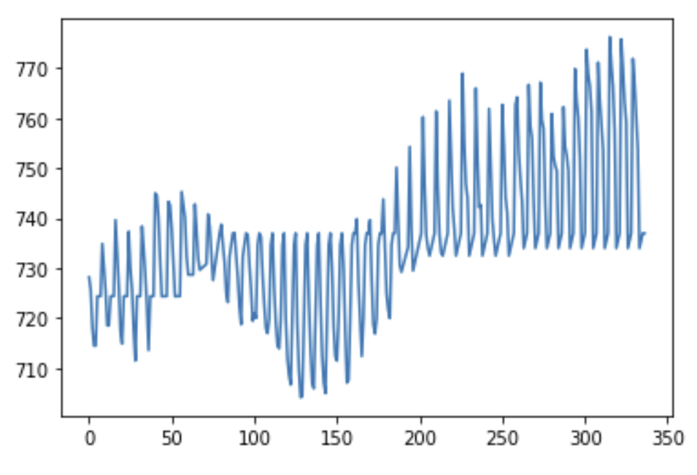
Cont. Understanding the Data
Data Spread of Closing price for the selected Commodity Soy Oil

Slide 6

Data Preparation
The Model details and build requires the data to be transformed into a processable format for which the below steps have been carried out
Data Pre-Processing:
Exclude the Soy Oil related Closing price observations explicitly
Normalizing the data using Min-Max Scaler
Thereby this normalized observations into an array
Completing above steps, the data thus processed is valid to be modelled using the LSTM Neural Network.
Post forecast modelling, the data is again reverse transformed to reflect original data values and same has been availed user through the User Interface output.

Slide 7

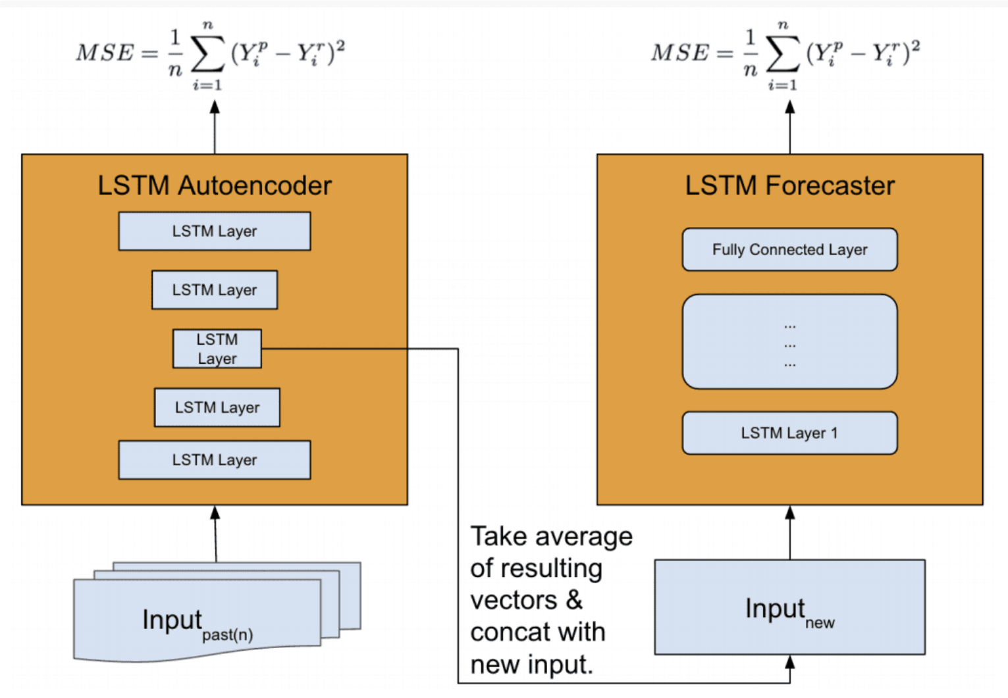
DECIDE/Develop Model
Perusal of the Data Model before Build
What is Time Series Data?
Properties of Time Series Data
Why LSTM?
Advantages/Efficiencies of LSTM model in Time series prediction
Having above questions answered it is learnt that the LSTM model is the deserving suit for predicting the stock prices. Below is a structural depiction of the network used in the current project where the type of loss is MSE (Mean Squared Error).
Source: Time-series Extreme Event Forecasting with Neural Networks at Uber

Slide 8

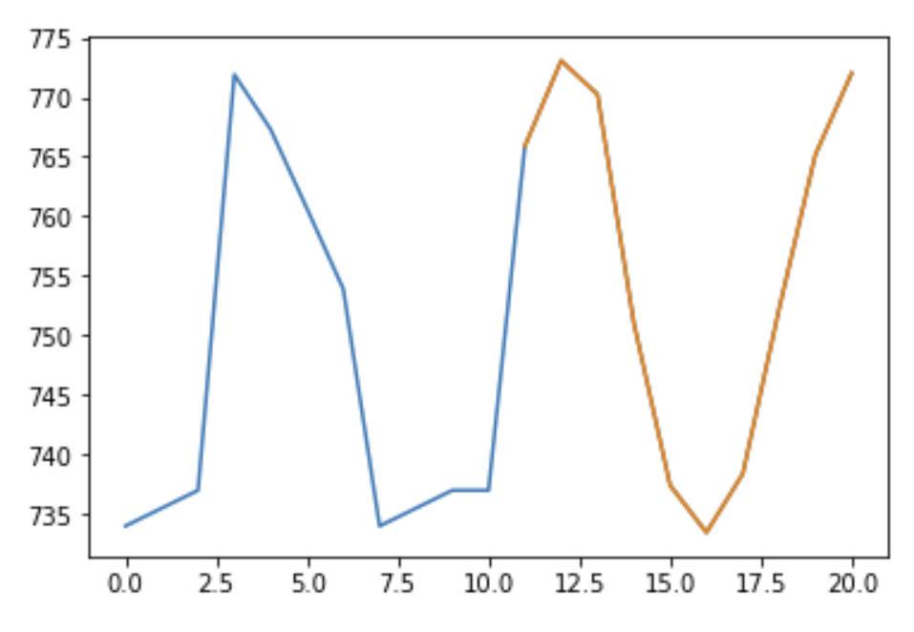
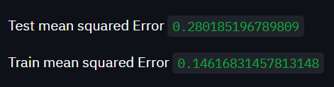
Model Results/Evaluation
The Model results with visuals are as shown
Data sample spread for selected Commodity
Forecasted line(Orange) for a test sample
LSTM

Slide 9

Deployment
Post Model forecast for a sample test values future observations, a web application integrating the model results to Streamlit application.
The Web application allows the users to select the time period ( from 0-10) days from the latest date to select
User can see the visual of the trend of currency closing price for selected price as well as the closing price values if required by checking the option for the same in the web application
Thus, by deploying the web application which allows the users to access the deep learning to see the future forecast of the desired stock price defines the project to be complete
Web Application URL: https://share.streamlit.io/siddheshm14/commodity_price_predictor/main/stockpredictor.py

Slide 10


Thank you

